Slide 1


Machine Learning Project
PRESENTED BY :
TANAY YADUKA
22070521086 7TH SEM
SECTION C

Slide 2
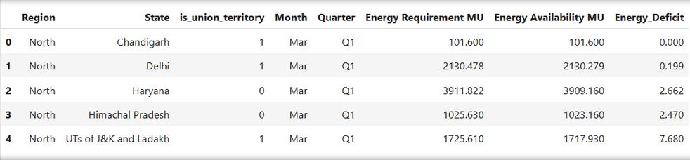
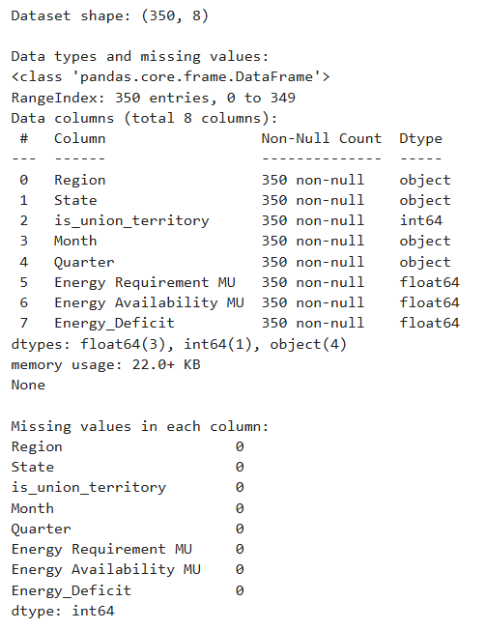
DATASET OVERVIEW: INDIA'S ENERGY PROFILE (TIME SERIES DATA)
Goal: Conduct a data-driven study on India's Energy Requirements
and Availability for predictive planning.
Data Scope & Provenance:
  SOURCE: OPEN GOVERNMENT DATA (OGD) PLATFORM INDIA .
    SOURCE AUTHORITY: MINISTRY OF POWER, GOVERNMENT OF INDIA.
  DATASET NAME: ENERGY REQUIREMENT AND AVAILABILITY.
  COVERAGE: DATA FOR VARIOUS STATES AND UTS.
  NATURE: TIME-SERIES DATASET, CAPTURING LONG-TERM
TRENDS AND FLUCTUATIONS.
INITIAL ASSESSMENT (REPORT CONFIRMATION):
  DATA QUALITY WAS HIGH, SUPPORTING ROBUST STATISTICAL MODELING.
  INITIAL VALIDATION FOUND NO DUPLICATE RECORDS OR MISSING VALUES.
  EXHIBITED A STRONG TIME-DEPENDENT STRUCTURE,
NECESSITATING SPECIFIC TIME SERIES ANALYSIS TECHNIQUES.

Slide 3
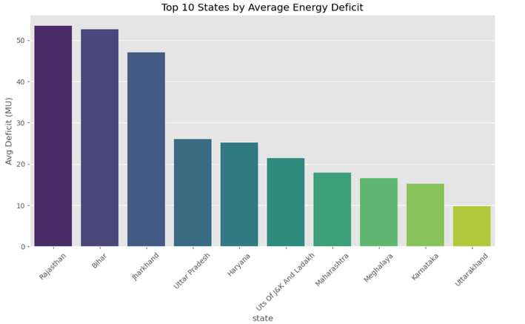
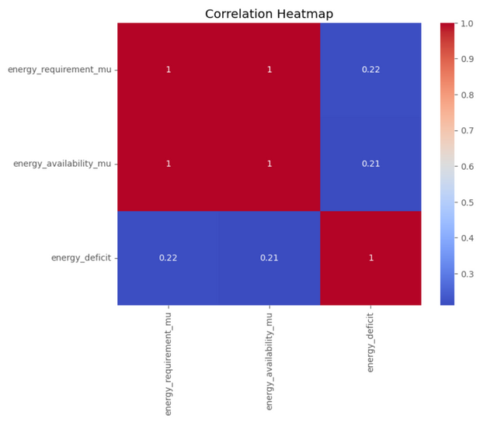
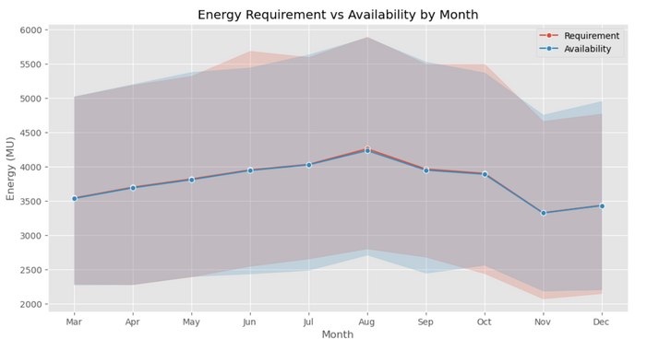
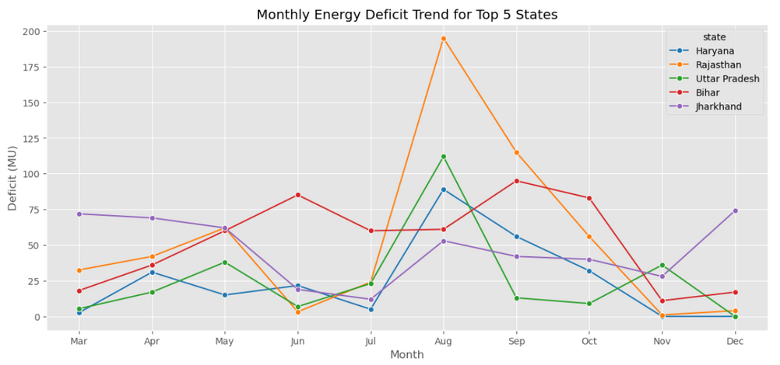
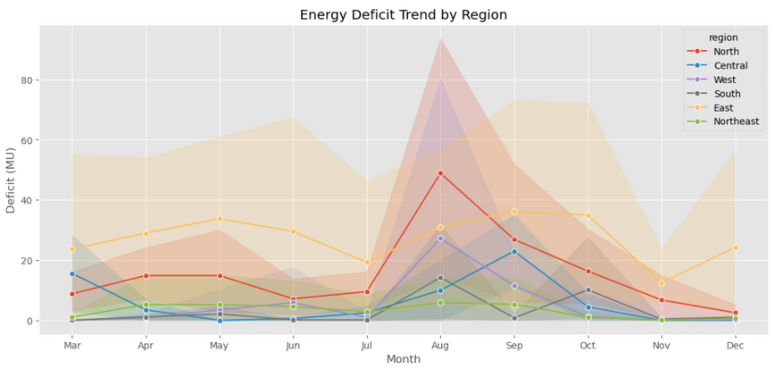
Insights from Exploratory Data Analysis
KEY FINDINGS FROM THE DATASET
  Identified key trends and patterns
  Analyzed correlations between variables
  Visualized data using graphs and charts
  Highlighted outliers and anomalies present
  Summarized statistical findings for clarity

Slide 4
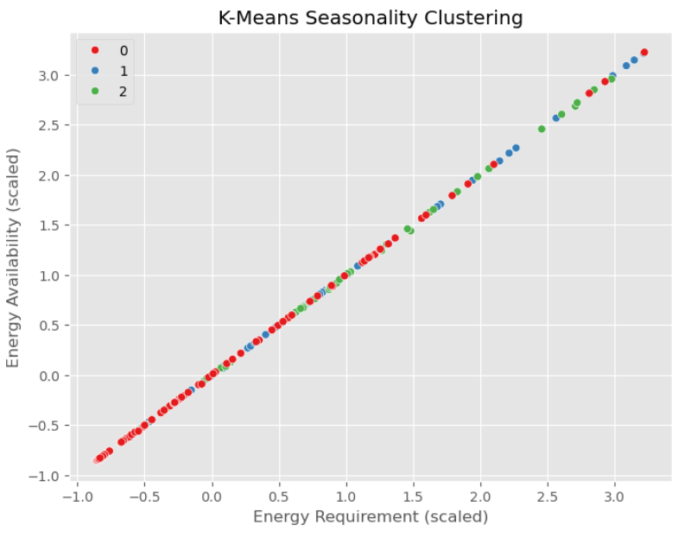
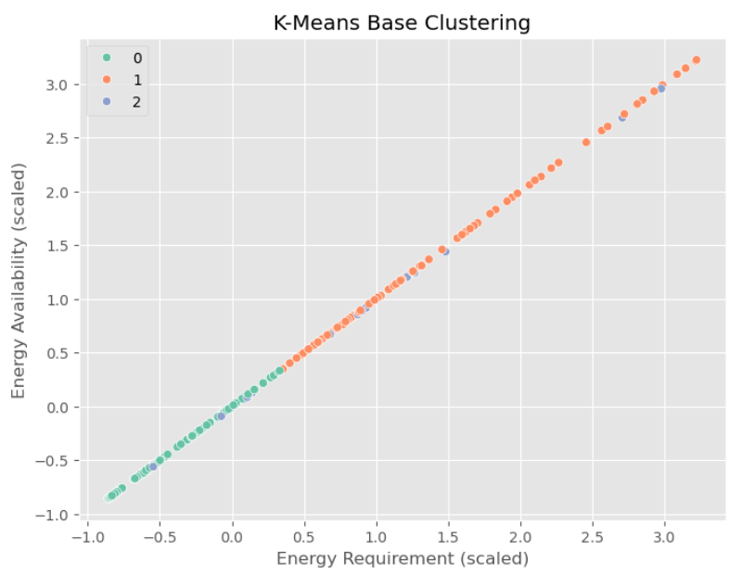
Machine Learning Model 1: K-Means Clustering
The best predictive model is the **Base Decision Tree** (or any perfect-scoring model with base features). The Decision Tree is preferred because it achieves 100% accuracy and provides the simplest, most transparent decision rule (a single split), offering maximum interpretability without sacrificing performance.

Slide 5
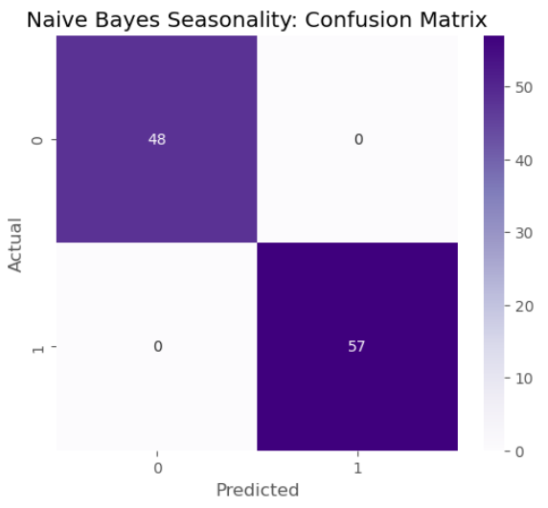
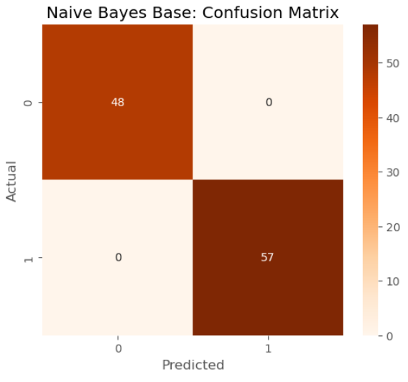
Machine Learning Model 2: Naive Bayes
Naive Bayes Base Accuracy: 1.0
Naive Bayes Seasonality Accuracy: 1.0
Overall Conclusion The Naive Bayes model is an ideal classifier for this problem, achieving 100% accuracy in distinguishing between the two classes. Given the perfect result, the simpler Base NB model is the most efficient choice, as the added complexity of seasonality features provides no benefit.

Slide 6
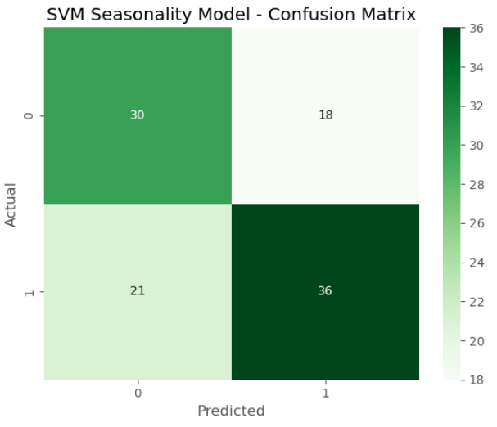
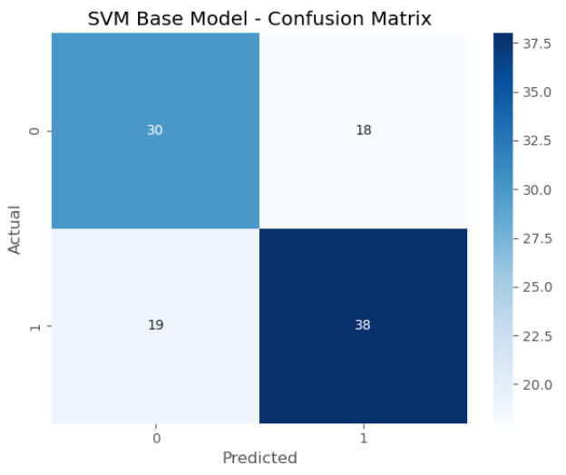
Machine Learning Model 3: Support Vector Machine
SVM Base Model Accuracy: 0.648
SVM Seasonality Model Accuracy: 0.629
Summary The SVM model is a poor classifier compared to the others tested (Logistic Regression, Naive Bayes), suggesting that the data is not easily separable by a fixed linear or polynomial boundary. Furthermore, the Base SVM is superior, confirming that the seasonality features are **detrimental to the SVM’s performance**.

Slide 7
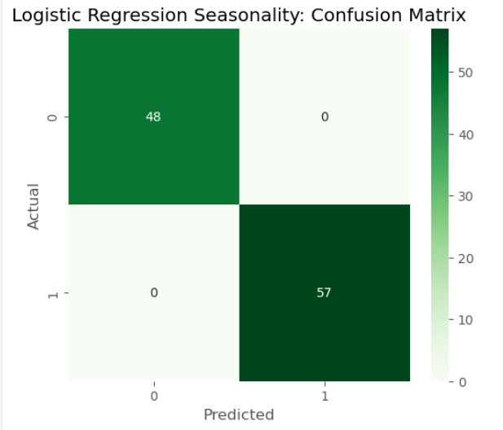
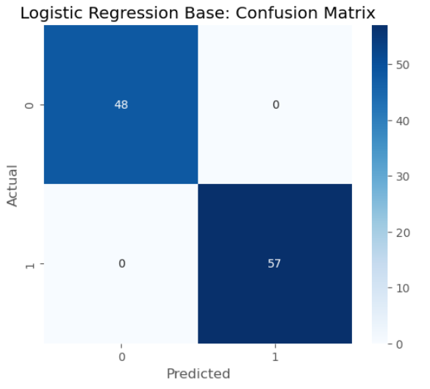
Machine Learning Model 4: Logistic Regression
Logistic Regression Base Accuracy: 1.0
Logistic Regression Seasonality Accuracy: 1.0
Overall Conclusion Logistic Regression is an ideal classifier for this problem, achieving 100% accuracy. Similar to the Naive Bayes results, this performance suggests that the underlying relationship between the input features and the target class is simple and highly distinct. The Base LR model is the most parsimonious choice due to its perfect performance with fewer features.

Slide 8
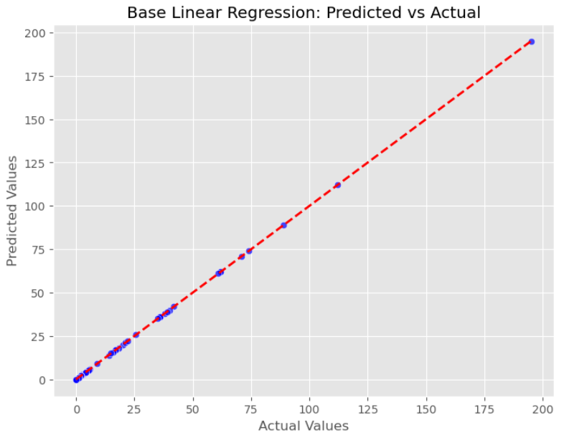
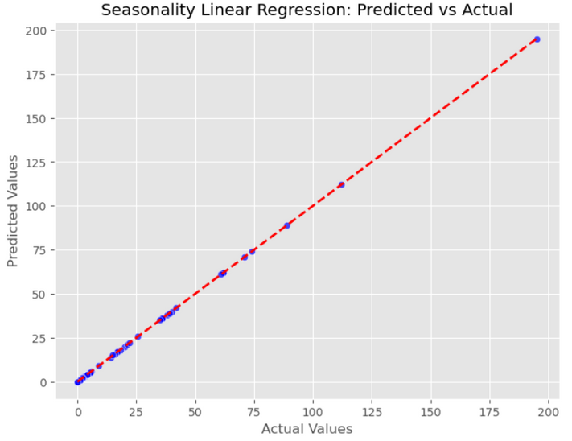
Machine Learning Model 5: Linear Regression
Linear Regression Base RMSE: 0.0
Linear Regression Base R²: 1.0
Linear Regression Seasonality RMSE: 0.0
Linear Regression Seasonality R²: 1.0
Overall Conclusion The Linear Regression model is an ideal predictor for this target variable. The R2 of 1.0 and RMSE of 0.0 are unusual for real-world data and suggest a direct, deterministic, and perfectly linear relationship between the independent and dependent variables. The Base Linear Regression model is the most efficient solution due to its perfect performance with fewer features.

Slide 9
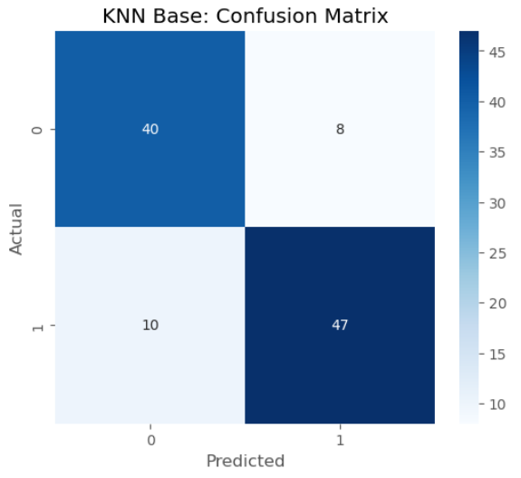
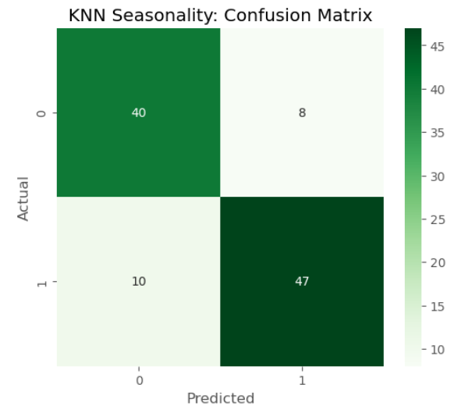
Machine Learning Model 6: KNN Classifier
KNN Base Accuracy: 0.829
KNN Seasonality Accuracy: 0.829
Summary The KNN models are reasonably accurate (82.9%) and perform consistently well across both classes (Recall ≈ 83.3% for Class 0 and 82.5% for Class 1). Crucially, the analysis reveals that seasonality features did not add predictive value to the base KNN model, suggesting that the spatial/locational features alone are sufficient for this level of classification performance.

Slide 10
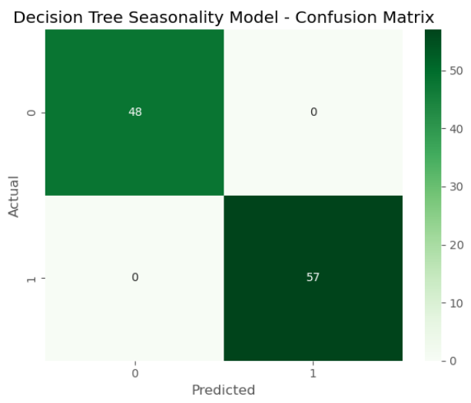
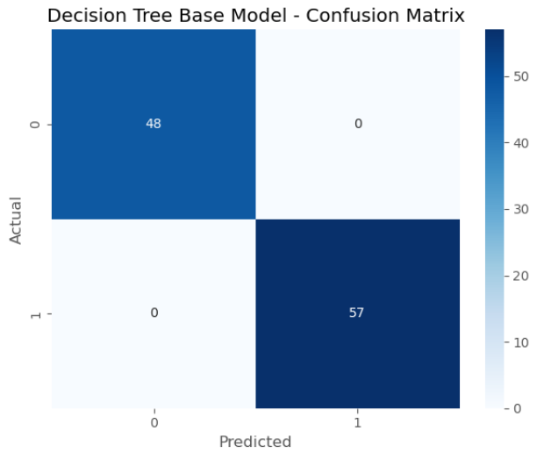
Machine Learning Model 7: Decision Trees
DECISION TREE BASE MODEL ACCURACY: 1.0
DECISION TREE SEASONALITY MODEL ACCURACY: 1.0
THE DECISION TREE MODEL IS THE MOST INTERPRETABLE AND EFFICIENT CLASSIFIER AMONG THE PERFECT-SCORING MODELS. ITS SINGLE-SPLIT STRUCTURE DEMONSTRATES THAT THE BINARY TARGET IS PERFECTLY DETERMINED BY A TRIVIAL THRESHOLD ON THE GAP FEATURE. AS SEEN WITH OTHER MODELS, SEASONALITY FEATURES WERE REDUNDANT.

Slide 11

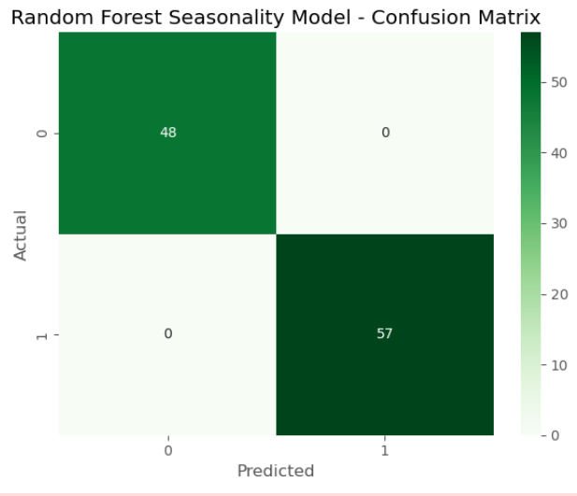
Machine Learning Model 8: Random Forest
Random Forest Base Model Accuracy: 1.0
Random Forest Seasonality Model Accuracy: 1.0
Overall Conclusion The Random Forest classifier performed perfectly, confirming the results from other robust models. Since the Decision Tree achieved perfect performance with a single simple split on the gap feature, the Random Forest ensemble technique, while more complex, does not offer a predictive advantage here. Given the perfect scores, the Base RF model is the preferred choice for its simplicity over the Seasonality RF model.

Slide 12

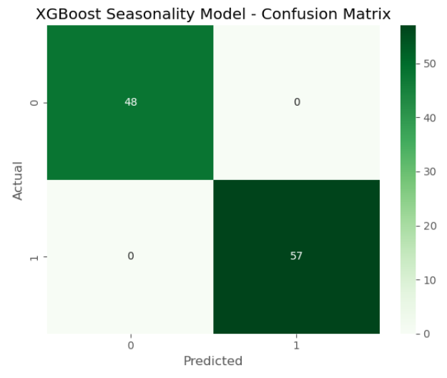
Machine Learning Model 9: XGBoost Classifier
XGBoost Base Model Accuracy: 1.0
XGBoost Seasonality Model Accuracy: 1.0
Overall Conclusion XGBoost, a powerful boosting ensemble, confirmed the perfect classification achieved by simpler models. Given that the Decision Tree achieved perfection with a single split, the highly complex structure of XGBoost is unnecessary for this problem. The Base XGBoost model is the preferred choice over the Seasonality version, as the added seasonal features provide no benefit.

Slide 13
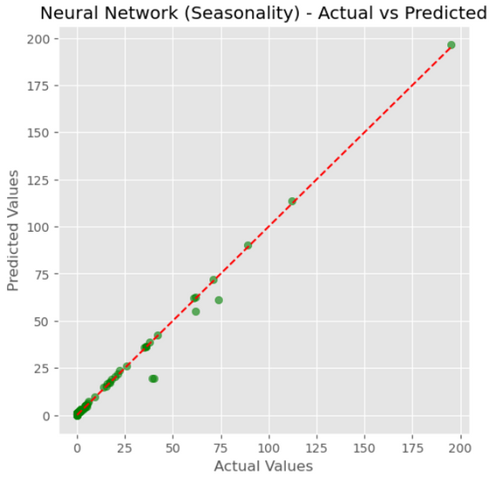
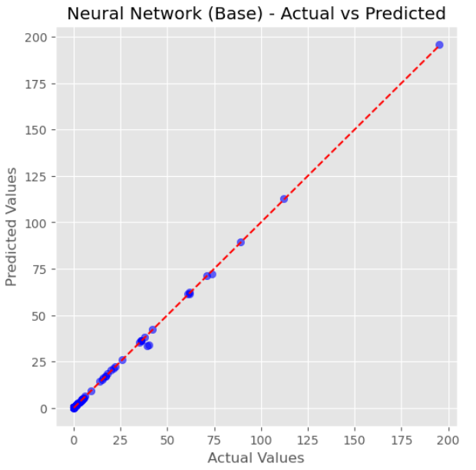
Machine Learning Model 9: Neural Network Models
=== Neural Network (MLP) Classification ===
Base MLP Accuracy: 0.59
Seasonality MLP Accuracy: 0.571
=== Neural Network (MLP) Regression ===
Base MLP RMSE: 0.878
Base MLP R²: 0.999
Seasonality MLP RMSE: 3.165
Seasonality MLP R²: 0.987
The MLP model was a classification failure but an excellent regressor (Base MLP), closely matching Linear Regression. The addition of the Seasonality features severely degraded performance in both tasks, confirming the Base MLP as the superior choice for energy forecasting.

Slide 14

Thank you!

